Slide 1
Solution Brief Description

Slide 2

Before accessing the code
Extract the zip file containing the solver package you can download HERE, and find the cbc.exe file (inside bin folder)
Then, change the directory once you open the python codes file
Find lines of snippet code like above inside the python codes, and adjust the directory in argument ‘executable=‘ like what I did above. In my case, I copy the bin\cbc.exe in my main C: disk.
By doing this procedures, you have done installing the cbc solver

Slide 3
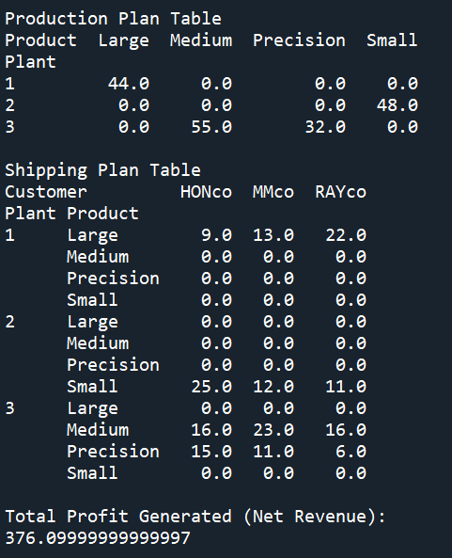
Codes 1
Upon running the codes, you will get this result on the right.
Essentially it shows the planning of production and shipping

Slide 4
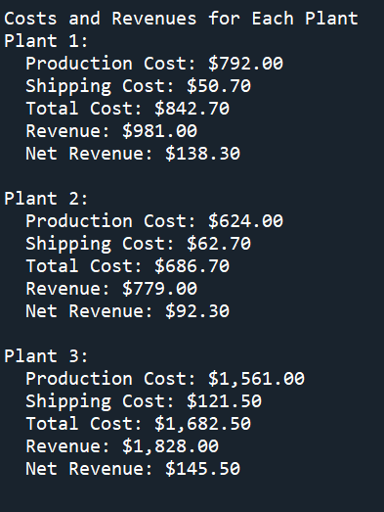
Codes 1 (con’t)
Upon running the codes, you will also get this result on the right.
Essentially it shows the revenue and cost for each plant

Slide 5
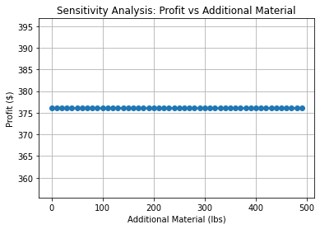
Codes 2
Upon running the codes, you will also get this result on the right.
Essentially it shows the marginal increase of profit upon adding additional material resources
It means the shadow price for material constraints is 0. Adding material will give no effect
Note: shadow price explains the maximum price which should be paid to obtain an additional unit of resource

Slide 6
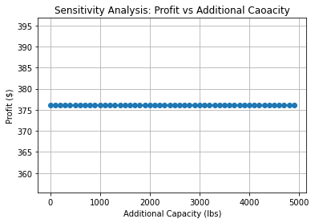
Codes 3
Upon running the codes, you will also get this result on the right.
Essentially it shows the marginal increase of profit upon adding additional inspection capacity resources
It means the shadow price for inspection capacity constraints is 0. Adding more capacity will give no effect
Note: shadow price explains the maximum price which should be paid to obtain an additional unit of resource

Slide 7
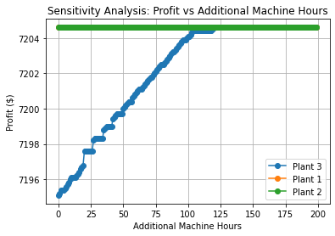
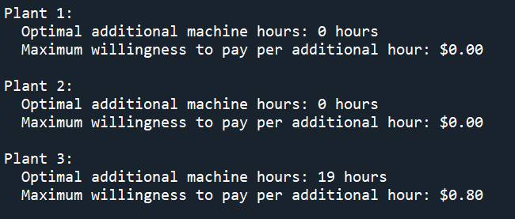
Codes 4
Upon running the codes, you will also get this result on the right.
Essentially it shows the marginal increase of profit upon adding machine hours for each plant
It means the shadow price for plant 3 which giving the best possible increase of profit, is 0.8 and after adding 19 hours, the profit is not increasing anymore as the constraint for the machine will be unbinding. (19 hours signifies the allowable increase)

Slide 8
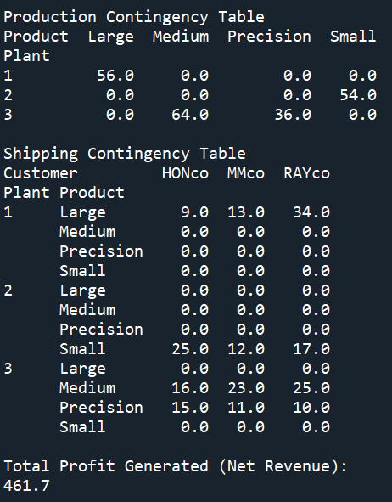
Codes 5
Upon running the codes, you will get this result on the right.
Essentially it shows the planning of production and shipping after adding 50% demand for RAYco
Note that total profit is increasing compared to without demand, this indicate that the model is opting to fulfill RAYco demand due to its sales price

Slide 9
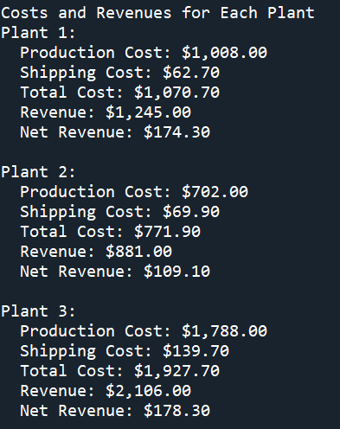
Codes 5 (con’t)
Upon running the codes, you will also get this result on the right.
Essentially it shows the revenue and cost for each plant after adding 50% demand for RAYco

Slide 10
Note
To switch the model to our own understanding, go to Demand Constraint function in Python Codes and change:
sum(model.ship[p, r, c] * sales_price[c][r] for p in plants) <= demand[c][r]
to become ->
sum(model.ship[p, r, c] for p in plants) <= demand[c][r]

